Slide 1

STUDENT
LINK
A SMART CAMPUS PLATFORM FOR STUDENTS

Slide 2
Batch No: 23 Guide Name: Prof. A R Bindiya
Project Title: Student Link- A Smart campus platform for students
USN | Student Name
01JST19CS044 | Devothama G N
01JST19CS128 | Shaman B H
01JST19CS034 | Chandana Raju
01JST19CS042 | Darshan M

Slide 3
Contents
1. Introduction
2. Objectives of our work
3. Methodology
4.Implementation
5.Snapshots of Implementation
6. Work Plan For Phase II
7.Conclusion

Slide 4
INTRODUCTION
01

Slide 5
The phrase "smart campus" refers to academic institutions that seamlessly integrate next-generation technologies into their infrastructure.
It increases more active interactions to encourage successful outcomes as today’s students are digital natives.
It allows for the creation of a "digitally connected" institution that can improve the on-campus experience, boost operational effectiveness, and deliver education that anyone can access right away.

Slide 6
The present approach does not seem user-friendly as all the features of the library, placement cell, and student login data to name a few, are not available on a single platform
The existing system is definitely vulnerable as its encryption standards are comparatively low and there is a high concern of infringement of privacy of the student information
The portal is frequently out of service. This makes it uncertain and non-reliable. The existing system does not foster any kind of virtual interaction among the students and faculty.

Slide 7
OBJECTIVES
02

Slide 8
Develop a culture of data creation and collection, analysis, application and availability.
Empowerment of interaction in productive ways among students, professors, other faculty, and the community by giving them the knowledge they need.
To create and maintain a digital campus —the next-generation campus that continually modernizes iteratively over time.

Slide 9
METHODOLOGY
03
Brief implementation of the project

Slide 10
5.1 BLOCKCHAIN SYSTEMS IN EDUCATION
As a very promising technology, blockchain has found high-quality applications in the field of education.
It will allow total independence of the students towards the institution and complete control over their data.
Data stored on the blockchain is permanently recorded and encrypted using cryptographic methods to ensure integrity, immutability through hash functions, and authenticity.
The most up-to-date university project is Blockcert, an open-source software that is currently based on the blockchain, using unique identifiers to store the hash of a certificate or to be the more precise bash of certificates. This allows systems to store any kind of certificate or any kind of data to the blockchain because it is not storing a document, but only its hash.

Slide 11
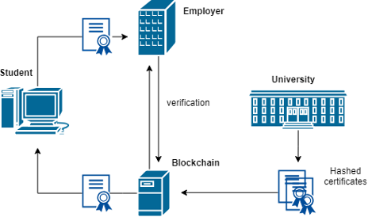
Components of a blockchain in an educational environment

Slide 12
5.2 SMART CONTRACTS
Smart contract is an executable program that is triggered when the system's state satisfies the contract's conditions or requirements.
Specifically, the diploma could be delivered to the student after the passing of all courses.
The smart contracts in education could be triggered after the fulfillment of all conditions required from the course, without any need for manual revision.
As an example, students would automatically receive a certificate upon acquiring a positive grade in the final exam, attending 80% of lectures and completing 25 exercises defined by the course.

Slide 13
IMPLEMENTATION
04

Slide 14
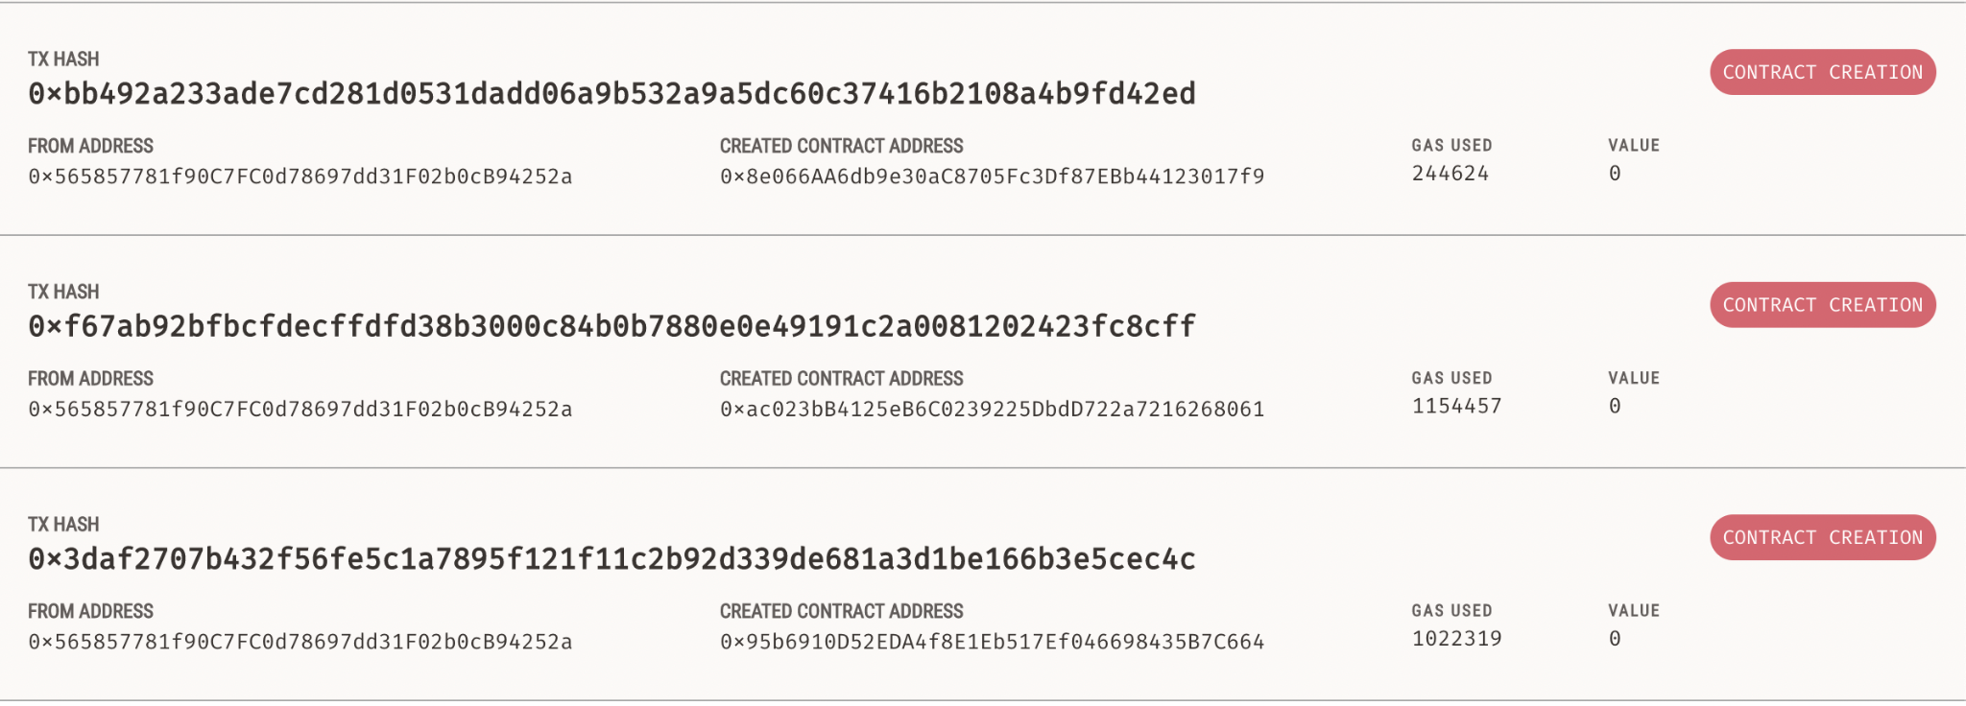
Ganache and Ganache-cli
Ganache is used for setting up a personal Ethereum Blockchain for testing your Solidity contracts.
Ganache is used in our project in order to deploy the smart contracts of the student profile.
We created two smart contracts SimpleStorage.sol and Education Contract.sol and deployed it to the local Blockchain provided by Ganache.

Slide 15
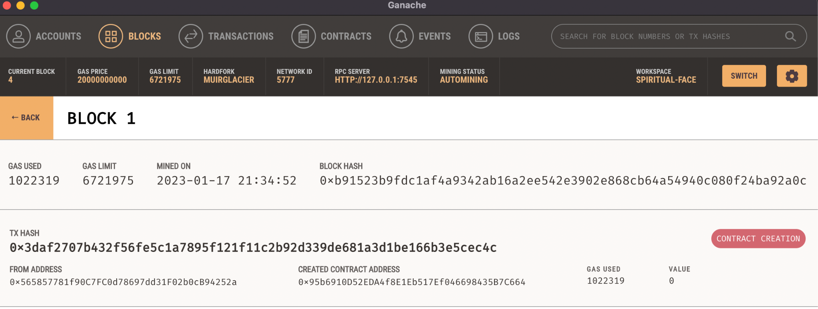

Slide 16
These two contracts will create two Blocks in Blockchain.
Truffle
Truffle is a one-stop solution for building DApps: Compiling Contracts, Deploying Contracts, Injecting it into a web app, Creating front-end for DApps and Testing.
It is a Development Environment, Testing Framework and Asset pipeline for Ethereum Blockchains.
MetaMask
MetaMask is an easy-to-use browser plugin (for Google-Chrome, Firefox and Brave browser), that provides a graphical user interface to make Ethereum transactions.
It allows you to run Ethereum DApps on your browser without running a full Ethereum node on your system. Basically, MetaMask acts as a bridge between Ethereum Blockchain(Ganache) and the browser

Slide 17
IPFS-Interplanetary File System
Blockchain is a decentralized data management platform that provides immutability, therefore it is a good choice to support file traceability metadata on a distributed file system like IPFS.
IPFS is a distributed system for storing and accessing files, websites, applications, and data.
We use infura for IPFS because it's free and provides easy-to-use IPFS API and gateway that can scale with your growing application.
Technology used
Ethereum - Ganache CLI
Web3
Solidity
IPFS
Truffle

Slide 18
FRONT END
The user interface used to interact with the user is developed the using the following
React JS - Javascript Framework
Bootstrap - CSS Framework
The login interface for student and institute and the record dashboard page are developed using the same.

Slide 19
SNAPSHOTS OF IMPLEMENTATION
05

Slide 20
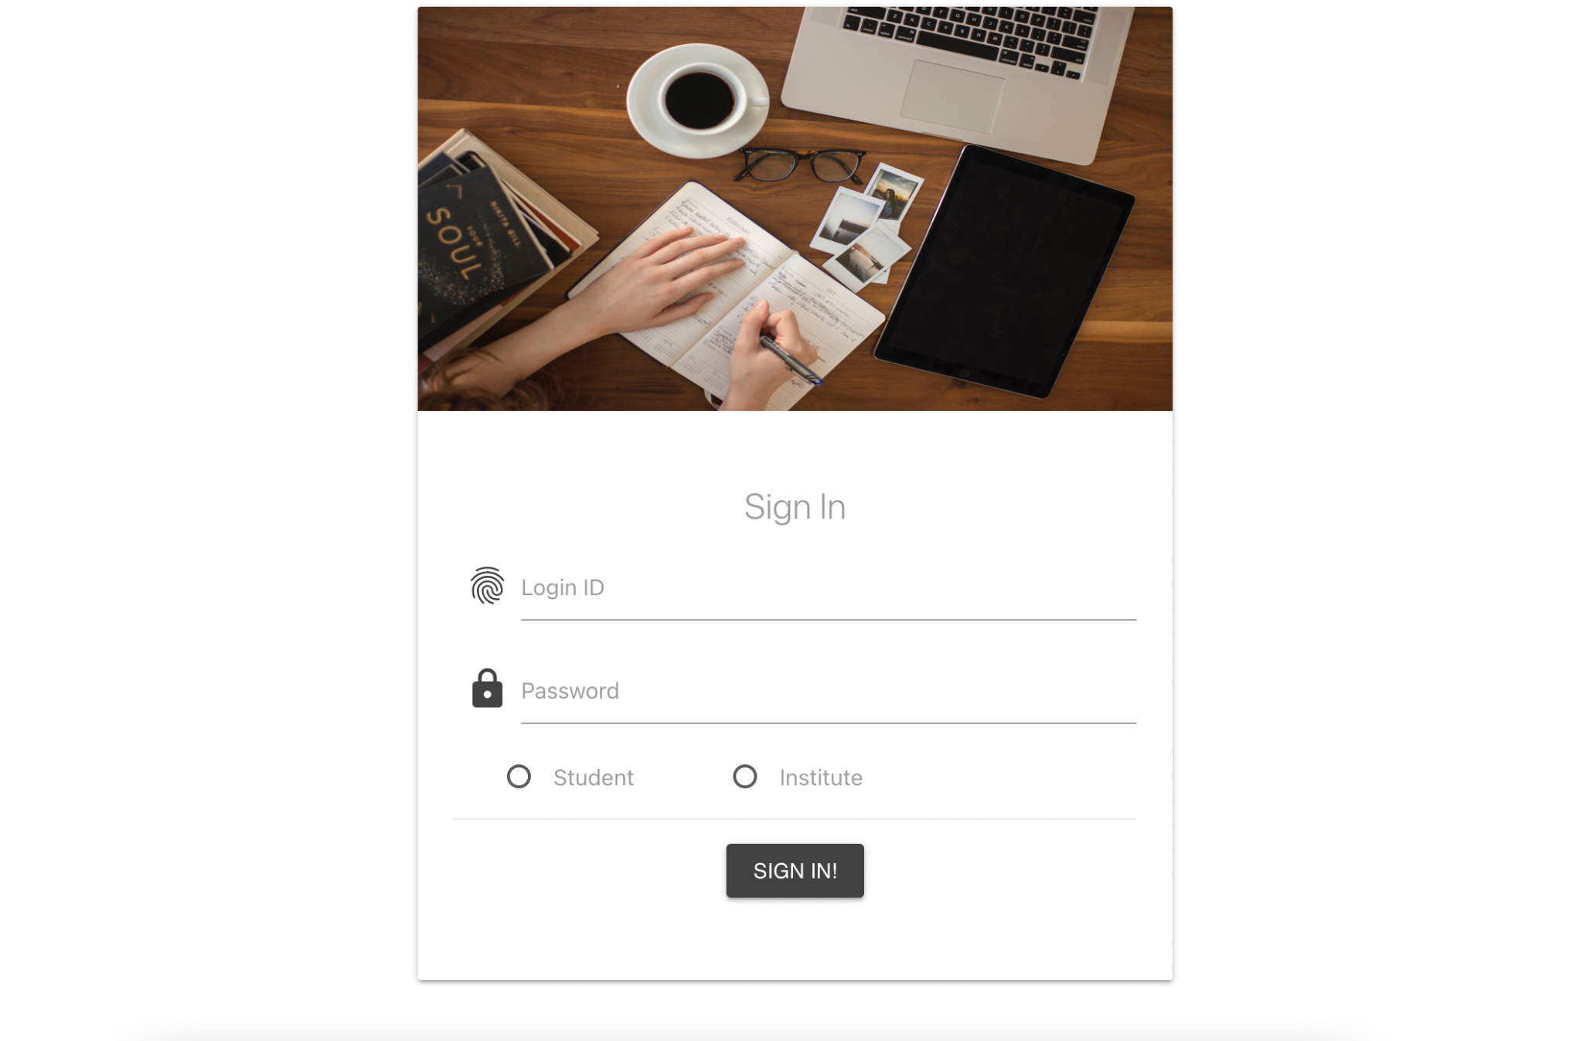

Slide 21
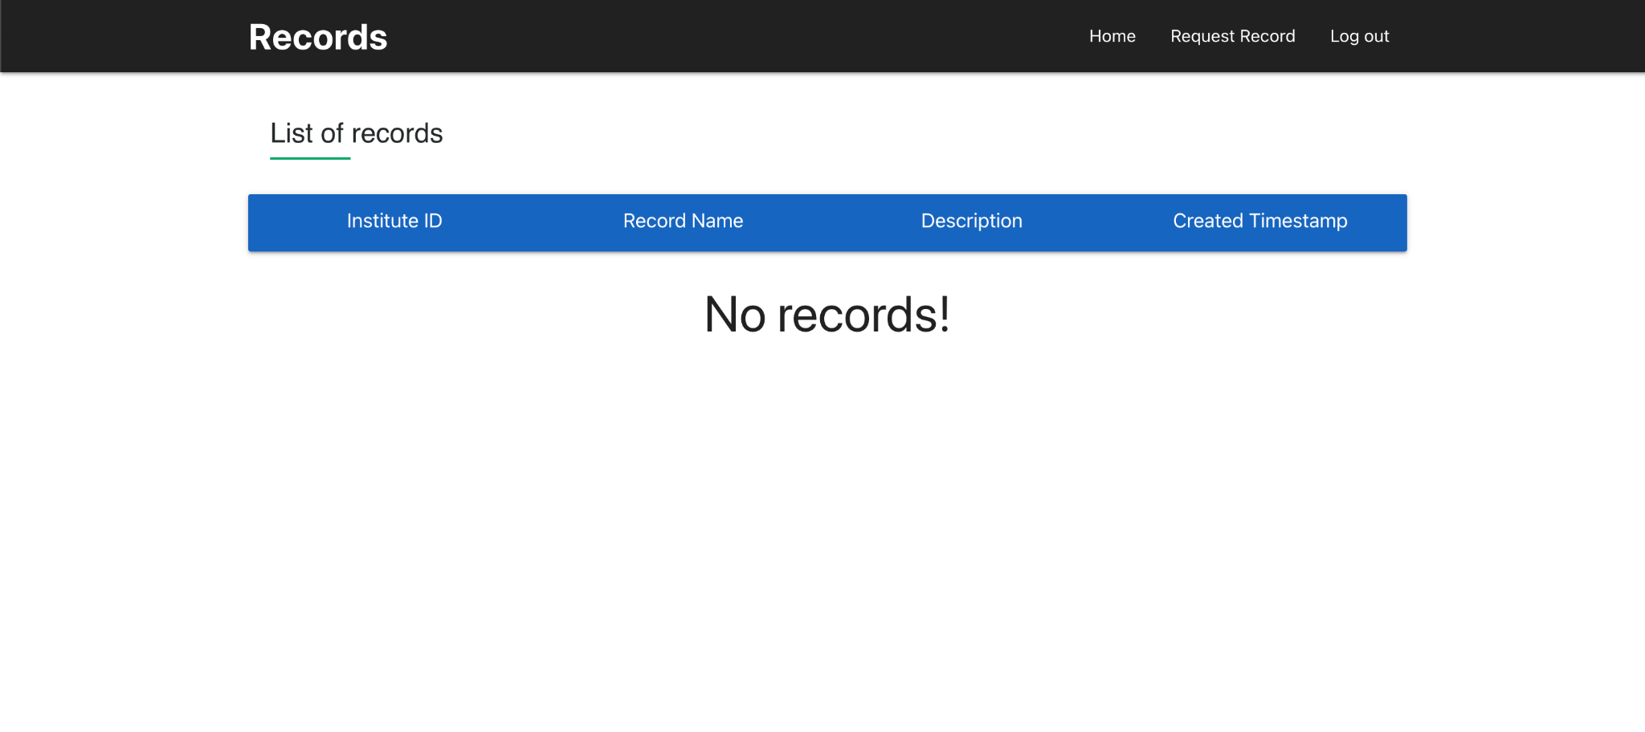

Slide 22
WORK PLAN FOR PHASE II
06

Slide 23
Phase 6: Integrating the frontend for the digital student profile system to smart contracts deployed on blockchain.
Phase 7: Creating the Interface for the Hostel management .
Phase 8: Creating Club Zone interface.
Phase 9: Creating bots for various clubs by collecting information from clubs.
Phase 10: Integrating campus navigation module and placement portal of the college.
Phase 11: Final deployment.

Slide 24
CONCLUSION
07

Slide 25
A smart campus can help improve three important factors: experience, efficiency, and education
It can help reshape how we interact on campus and it can be the proper way for the transformation that will enable campuses to address the future of learning and work while improving the campus experience
Our project mainly aims at digitizing crucial practices on the campus and also connecting all parts of the campus on a single portal where the availability of resources is of utmost concern.
Imagine if these technologies communicated in a manner that effortlessly initiated positive outcomes through intuitive and intelligent interactions.

Slide 26
Thank You!

